Slide 1
Fundamental Hardware Components
Central processing unit (CPU) – the “brain” of a computer system. Interprets and executes instructions.
Main memory – is where currently executing programs reside. It is volatile, the contents are lost when the power is turned off.
Secondary memory – provides long-term storage of programs and data. Nonvolatile, the contents are retained when power is turned off. Can be magnetic (hard drive), optical (CD or DVD), or flash memory (USB drive).
Input/output devices – mouse, keyboard, monitor, printer, etc.
Buses – transfer data between components within a computer system. System bus (between CPU and main memory).

Slide 2
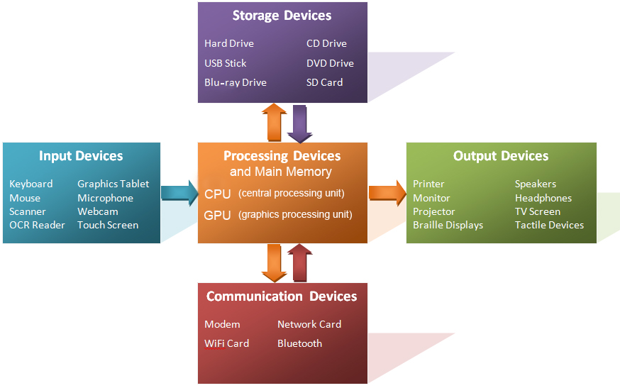

Slide 3
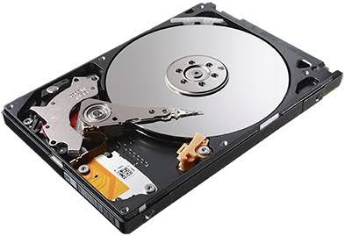
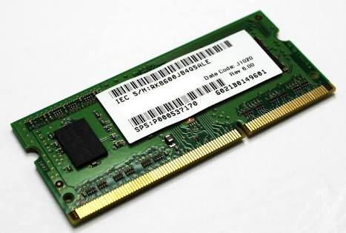
Hard disk
RAM

Slide 4
Computer Architecture
Differences
CPU
Register
Fast
Small
Expensive
Volatile
Cache
RAM
Main memory
Slow
Large
Cheap
Stable
Disk, Tape..
Secondary storage

Slide 5
Storage Hierarchy
unit price
Volatile
Cache
Primary storage
Memory
Secondary storage
Magnetic Disk
Non-volatile
Tertiary storage
Magnetic tape
speed

Slide 6
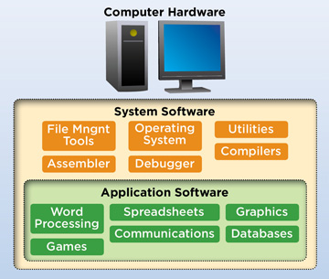
Software components

Slide 7
System software Vs application Software
System Software:
System software is used to operate computer hardware, it provides a platform to run application software.
Language - Written in low-level language that is assembly language
Run - It starts running when the system is turn on till system is turned off.
Requirement - Without system software, a system is unable to run.
Purpose - It is general purpose.
Example - Operating System
Application Software:
Application software is used by user for performing a specific task.
Language - Written in high-level language that is C, C++, Java, etc.
Run - It starts running when user request.
Requirement - It is user specific so application software not required to run the system.
Purpose - Application software is the specific purpose.
Example - Microsoft Office, Photoshop

Slide 8
Operating Systems
An operating system is software that manages and interacts with the hardware resources of a computer.
Because an operating system is intrinsic to the operation of a computer, it is referred to as system software.
Functions of OS
Memory Management
File Management
Control over system performance
Security

Slide 9
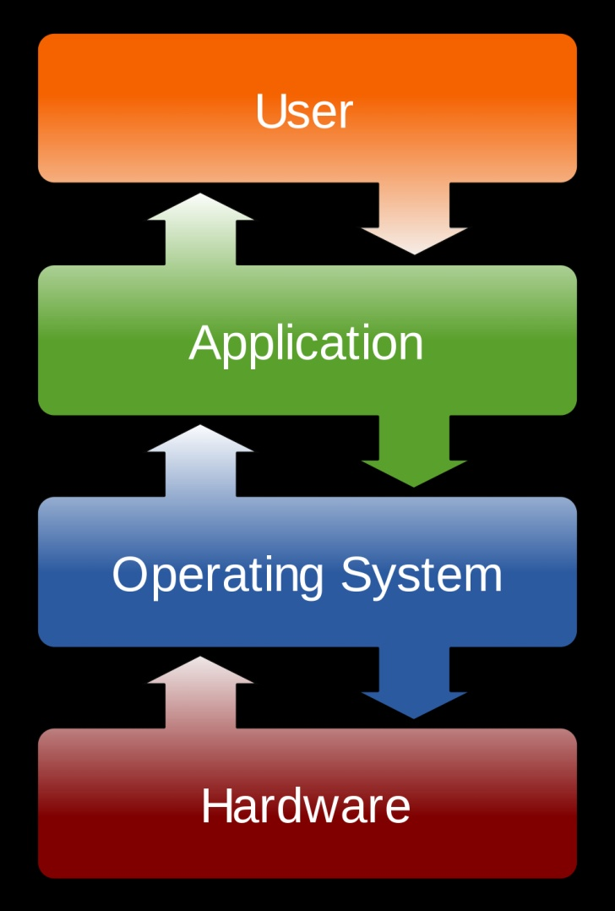

Slide 10
Number Systems
Decimal Number System
Base 10 (0-9)
Octal Number System
Base 8 (0-7)
Hexadecimal Number System
Base 16 (0-9 and A-F)
Binary Number System
Base 2(0-1)
Number system prefix for Python numbers
Number System | Prefix
Binary | '0b' or '0B'
Octal | '0o' or '0O'
Hexadecimal | '0x' or '0X'

Slide 11
Decimal Numbers
(1 x 1000)+ (2 x 100)+ (3 x 10)+ (4 x l)
(1 x 10³)+ (2 x 10²)+ (3 x 10¹)+ (4 x l0⁰)
1000 + 200 + 30 + 4
1234

Slide 12
Octal Numbers
step | Octal Number | Decimal Number
Step 1 | 12570₈ | ((1 x 8⁴) + (2 x 8³) + (5 x 8²) + (7 x 8¹) + (0 x 8⁰))
Step 2 | 12570₈ | (4096 + 1024 + 320 + 56 + 0)
Step 3 | 12570₈ | 5496₁₀

Slide 13
Hexadecimal numbers
step | Hexadecimal Number | Decimal Number
Step 1 | 19FDE₁₆ | ((1 x 16⁴) + (9 x 16³) + (F x 16²) + (D x 16¹) + (E x 16⁰))₁₀
Step 2 | 19FDE₁₆ | ((1 x 16⁴) + (9 x 16³) + (15 x 16²) + (13 x 16¹) + (14 x 16⁰))₁₀
Step 3 | 19FDE₁₆ | (65536+ 36864 + 3840 + 208 + 14)₁₀
Step 4 | 19FDE₁₆ | 106462₁₀

Slide 14
Binary Numbers
Step | Binary Number | Decimal Number
Step 1 | 10101₂ | ((1 x 2⁴) + (0 x 2³) + (1 x 2²) + (0 x 2¹) + (1 x 2⁰))
Step 2 | 10101₂ | (16 + 0 + 4 + 0 + 1)
Step 3 | 10101₂ | 21₁₀

Slide 15
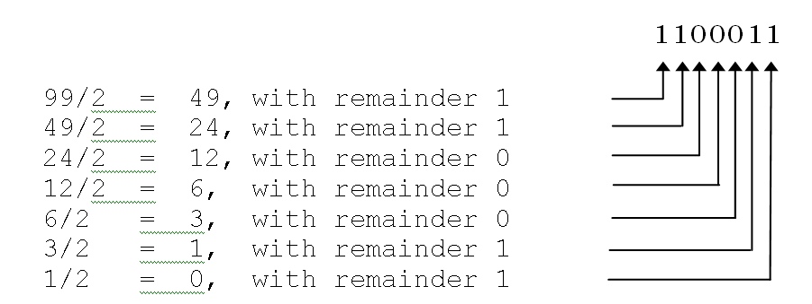
Bits and Bytes
Each binary digit is referred to as a bit. A group of (usually) eight bits is called a byte. Converting a base ten number to base two involves the successive division of the number by 2.

Slide 16
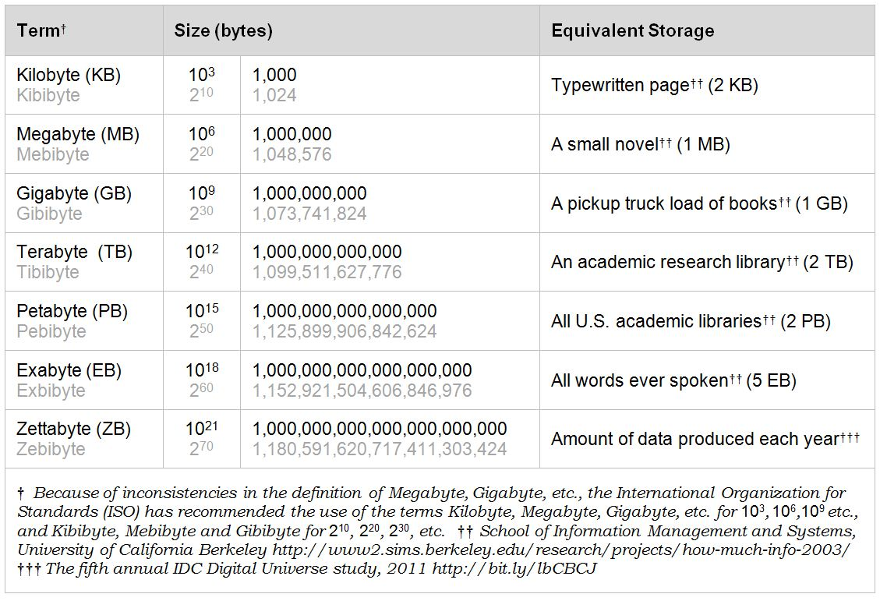

Slide 17
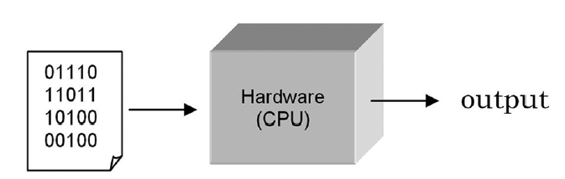
Machine level language
1 0 0 1 01 01 01 01 1 1 1 1 1 1 0 00 0 0 0 00 00 1 0 0 1 01 01
01 1 1 1 1 1 1 0 00 0 0 0 00 00 0 1 0 0 000 1 1 1 1 1 1 1 1 1 1
00000000000001111111111111111111111 1 0 0 1 01 01 01
1 1 1 1 1 0 00 0 0 0 00 00 1 0 0 1 01 01 01 01 1 1 1 1 1 1 0 00
0 00 00 1111111111111111111111

Slide 18
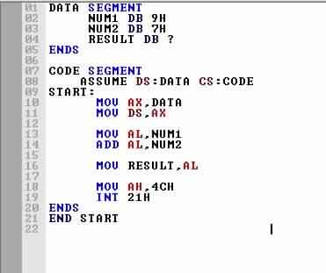
#program to add two numbers
num1=int(input("Enter first number"))
num2=int(input("Enter second number"))
res=num1+num2
print("sum of two numbers is ",res)
High level language program
Assembly level language program

Slide 19
Program Translation
A central processing unit (CPU) is designed to interpret and execute a specific set of instructions represented in binary form (i.e., 1s and 0s) called machine code. Only programs in machine code can be executed by a CPU.

Slide 20
Writing programs at this “low level” is tedious and error-prone. Therefore, most programs are written in a “high-level” programming language such as Python. Since the instructions of such programs are not in machine code that a CPU can execute, a translator program must be used.
There are two fundamental types of translators:
Compiler translates programs into machine code to be executed by the CPU
Interpreter executes instructions in place of the CPU

Slide 21
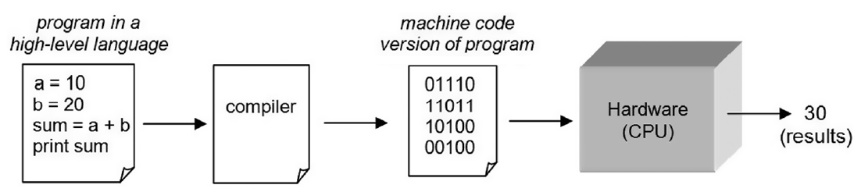
Compiler
Compiled programs generally execute faster than interpreted programs.

Slide 22
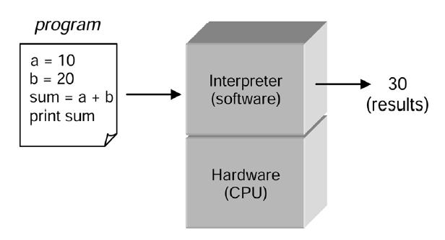
Interpreter
An interpreter can immediately execute instructions as they are entered. This is referred to as interactive mode. This is a very useful feature for program development. Python, as we shall see, is executed by an interpreter.

Slide 23
Interpreter Vs compiler
Interpreter | Compiler
Translates program one statement at a time. | Scans the entire program and translates it as a whole into machine code.
No intermediate object code is generated, hence are memory efficient. | Generates intermediate object code which further requires linking, hence requires more memory.
Programming language like PHP ,PERL Python, Ruby use interpreters. | Programming language like C, C++ use compilers.

